Slide 1
Design and Analysis of Algorithm
UNIT-II
Greedy Algorithm
M Yogi Reddy
Assistant Professor,
Dept. of CSE,
School Of Technology,
GITAM(Deemed to be ) University,
Hyderabad.

Slide 2

Contents
Job Sequencing Algorithm
Knapsack Problem
Optimal storage on tapes [Huffman coding]
Minimum cost spanning trees
Single source shortest paths
1
2
3
4
5

Slide 3
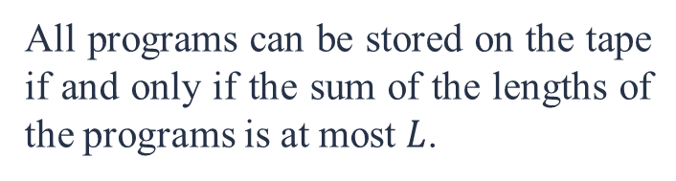
Optimal Storage on Tapes
The problem:
There are $n$ programs that are to be stored on a computer tape of length $L$. The lengths of these $n$ programs are $l_{1}, l_{2} , . . . , l_{n}$ respectively.
All programs can be stored on the tape if and only if the sum of the lengths of the programs is at most $L$.
We assume that whenever a program is to be retrieved from this tape, the tape is initially positioned at the front.

Slide 4
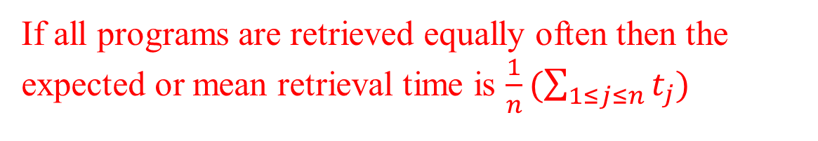
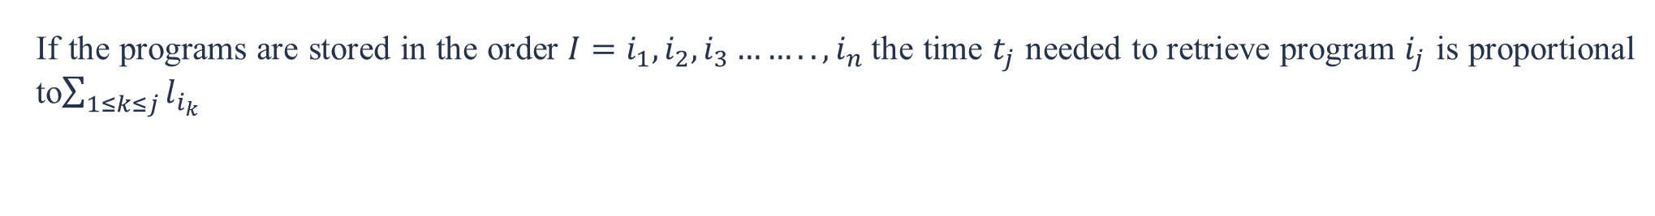
Mean Retrieval Time
If the programs are stored in the order $I=i_{1}, i_{2},i_{3}……..,i_{n}$the time $t_{j}$ needed to retrieve program $i_{j}$ is proportional to$\sum_{1≤k≤j}{l_{i_{k}}}$
a
b
c
d
e
If all programs are retrieved equally often then the expected or mean retrieval time is $\frac{1}{n}(\sum_{1≤j≤n}{t_{j}})$
Objective:
We are required to find a permutation for the n programs so that when they are stored on the tape in this order the MRT is minimize

Slide 5
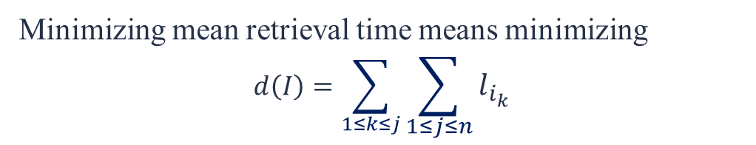
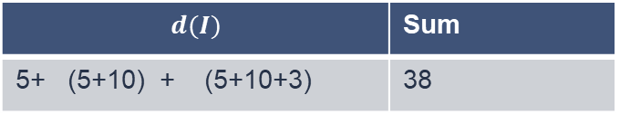
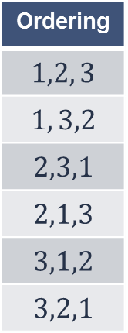

Minimizing MRT
Minimizing mean retrieval time means minimizing
$$d\left(I\right)=\sum_{1≤k≤j}{\sum_{1≤j≤n}{l_{i_{k}}}}$$
Example: Let n = 3 and $(l_{1}, l_{2}, l_{3})= (5,10,3)$.
There are $n!= 6$possible orderings.
Ordering
$$1,2, 3$$
$$1, 3,2$$
$$2,3,1$$
$$2,1,3$$
$$3,1,2$$
$$3,2,1$$
$$d(I)$$ | Sum
5+ (5+10) + (5+10+3) | 38
Sum / n
38/ 3
31/3
41/3
41/3
29/3
34/3
It’s clear, the 5th order in storing the programs, the mean retrieval time is least.
5+ (5+3) + (5+3+10) | 31
10+ (10+3) + (10+3+5) | 41
10+ (10+3) + (10+3+5) | 41
3+ (3+5) + (3+5+10) | 29
3+ (3+10) + (3+10+5) | 34

Slide 6
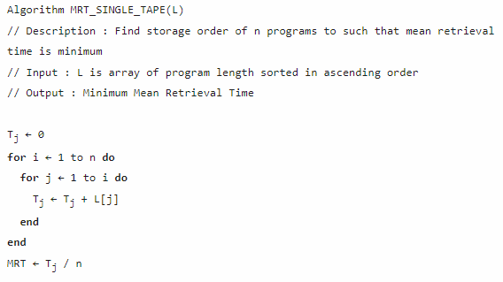
Algorithm

Slide 7
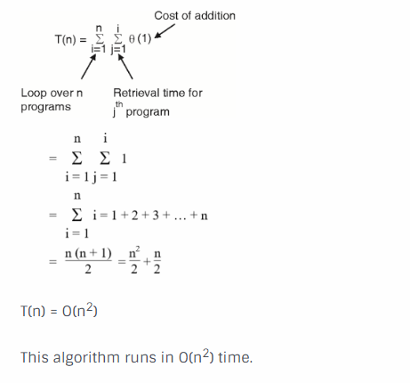
Complexity analysis
Primitive operation in above algorithm is the addition of program length, which is enclosed within two loops. The running time of algorithm is given by,

Slide 8
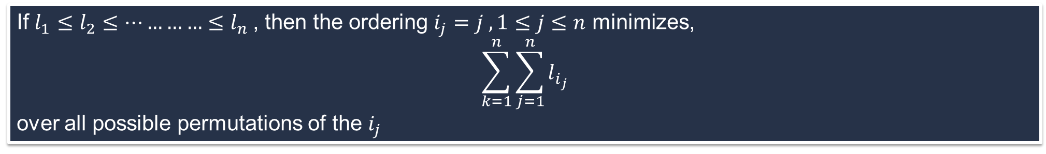
Theorem
If $l_{1}≤l_{2}≤…………≤l_{n}$, then the ordering $i_{j}=j , 1≤j≤n$ minimizes,
$$\sum_{k=1}^{n}{\sum_{j=1}^{n}{l_{i_{j}}}}$$
over all possible permutations of the $i_{j}$
Proof
Do the proof of this theorem in assignment

Slide 9
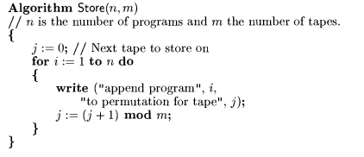
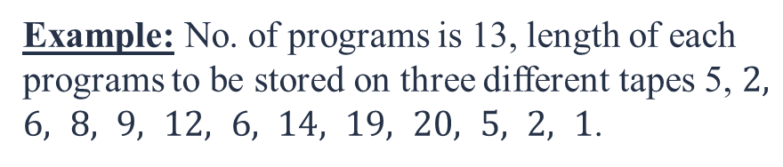
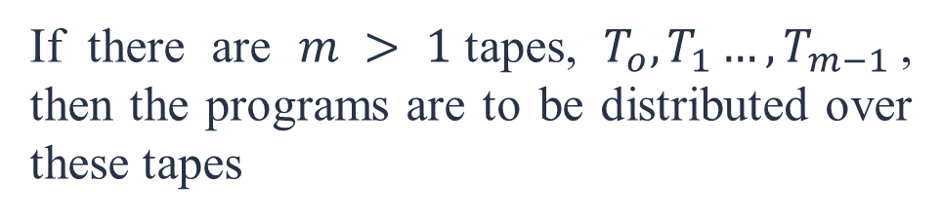
Multiple Tapes
The tape storage problem can be extended to several tapes
If there are $m > 1$tapes, $T_{o},T_{1}…,T_{m−1 }$, then the programs are to be distributed over these tapes
Example: No. of programs is 13, length of each programs to be stored on three different tapes 5, $2, 6, 8, 9, 12, 6, 14, 19, 20, 5, 2, 1$.
1 | 5 | 6 | 12 | 20
2 | 5 | 8 | 14
2 | 6 | 9 | 19

Slide 10



